Slide 1

A shiny GUI for nlmixr: shinyMixR
Stockholm, Sweden, June 11th 2019
Mirjam N. Trame
On behalf of the nlmixr development team:
Matt Fidler, Richard Hooijmaijers, Teun Post, Rik Schoemaker, Mirjam Trame, Justin Wilkins, Yuan Xiong and Wenping Wang

Slide 2
nlmixr and shinyMixR - background
There are two main ways of working with nlmixr models:
Via the nlmixr package
nlmixr is the engine for running models
Provides output in a model fit object, which can be read out and approached
R cannot be used while running models – new R session can be opened
Model fit object is in the global environment
Via the shinyMixR package
Provides a graphical user interface around nlmixr
Structures a project
Models are submitted in separate sessions – R can be used while running models
Model fit object is automatically saved to disk
Modeling output and models run via nlmixr cannot be imported
Note: several shinyMixR package functions can also be used interactively on command line

Slide 3
shinyMixR
https://richardhooijmaijers.github.io/shinyMixR/index.html

Slide 4
Introduction
The shinyMixR package is a graphical user interface (GUI) tool for managing pop PKPD projects with nlmixr as the estimation engine
The package is intended to view, edit, run, compare, analyze and report nlmixr models
It organizes your project – model, data, metadata, settings and results are kept together
The interface enables browsing between specific project folders
The application can be started via a shortcut or via the R command line in the project folder
The interface is created using the shiny and shinydashboard packages
Note: most functions within the package can also be used in an interactive R session
The package is open source and is available at: https://richardhooijmaijers.github.io/shinyMixR/index.html

Slide 5
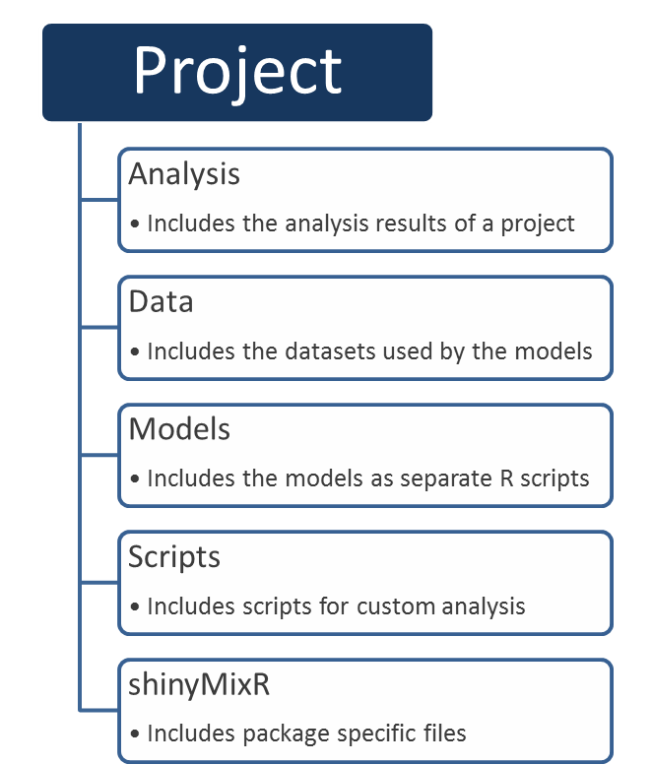
Project Structure
The folder structure of a shinyMixR project is fixed and should be followed to enable to work with the package*:
The folder structure is important because:
The package monitors changes in specific folders and keeps track of this in a project object
Files are read and saved from specific locations to disk
When working with many models an organized folder structure is key – model, data, metadata, setting and results are kept together
*functionality to automatically build the folder structure is present in the package

Slide 6
Project Object
To manage the information within the project structure, a project object is maintained:
The object has information regarding the available models, meta data, high level results, etc.
All changes within a project are monitored/saved to disk in this object:
When model is changed
When new results are generated
When data is deleted
Within the interface this is done automatically, or using refresh buttons (e.g. the interface does not “know” when a model is finished and new results are present)
Note: for an interactive session, in some cases updating of this object can be done using the get_proj() function

Slide 7
nlmixr and shinyMixR - nuances
nlmixr – model and nlmixr fit function
m1 <- function() {
ini({
tka <- .5
tcl <- -3.2
…
run nlmixr()via R or use the Run model(s) widget via shinyMixR
fit1 <- nlmixr(m1, theo_sd, est="saem", … )
shinyMixR – metadata and run button or run_nmx function
run1 <- function() {
data = "theo_sd" # csv or rds file
desc = "case example base run" # model description
ref = "" # model reference
imp = 1 # model importance
est = "saem" # estimation method
control = list() # est control options
ini({
tka <- .5
tcl <- -3.2
…
nlmixr arguments moved to metadata within the model code (run1.R model file) – analogous to NONMEM $PROBLEM, $DATA, $EST, etc.
shinyMixR stores results in R data objects (e.g. run1.res.rds)

Slide 8
Overview of shinyMixR functionality
Edit Models
Run Models
The edit model(s) widget is used to edit models within an editor including syntax coloring (using shinyAce).
It is also possible to create new models using various templates or to duplicate existing models.
The run model(s) widget is used to run models. It is possible to run one or multiple models at once.
It is also possible to assess the intermediate output or progress for an nlmixr run.
data in the data folder; models in the model folder

Slide 9
Overview of shinyMixR functionality
Parameter Estimates
GOF Plots
The parameter estimates widget is used to generate a table with parameter estimates. In case multiple models are selected the table will show the results of each run in a separate column.
The goodness of fit widget is used to generate a combination of 4 goodness of fit plots combined.
By default nlmixr.xpose is used but direct ggplot2 can also be used directly by specifying this in the settings widget.
Output stored in the analysis folder; fit results and specific files in the shinyMixR folder

Slide 10
Overview of shinyMixR functionality
Fit Plots
Scripts
It is possible to write your own scripts (See scripts folder and scripts widget) that can be used to analyze model results.
The scripts can be used to process the result for one or multiple models at once (the interface will include the name of the selected models in the script).
The fit plots widget is used to generate individual fit plots. The same plotting options are present here as for the goodness of fit plots.
Output stored in the analysis folder; scripts in the scripts folder; fit results and specific files in the shinyMixR folder

Slide 11
Overview of shinyMixR functionality
Analysis results
Output from Scripts and Widgets (plots and tables) are available in the Analysis results widget.
It is possible to save, view and combine the results from the models within a project into an HTML or PDF (if LaTeX is present) document.
Output stored in the analysis folder

Slide 12
Summary of shinyMixR
The shinyMixR package is a graphical user interface (GUI) tool for managing popPKPD projects with nlmixr as the estimation engine
It structures your project – model, data, metadata, settings and results are kept together and saves the results to disk
The interface enables browsing between specific project folders
The package has functionalities to view, edit, run, compare, analyze and report nlmixr models
Models are submitted in separate sessions – R can be used while running models
https://richardhooijmaijers.github.io/shinyMixR/index.html

Slide 13
Back-up

Slide 14
Create New Project (general) – via shinyMixR command line
Create a folder for your project (e.g., <ProjectFolder>)
Open R or RStudio and set the working directory to your project folder (e.g., <ProjectFolder>)
Use setwd(), or
via Rstudio: Session > Set working directory > Choose directory
On the command line or in a script run
library(shinyMixR, quietly=TRUE)
create_proj() (only needed once per project)
By default, the folder structure is created within the current directory, if not present. The following folders are created:
analysis, data, models, scripts, shinyMixR
Once there is a folder structure present, the interface can be started:
On the command line or in a script run
library(shinyMixR, quietly=TRUE); run_shinymixr(launch.browser=TRUE)
Note: other functions like run_nmx() can also be used directly on the command line or in a script to run models
Start creating and running your models
If needed, supplied Model(s) can be copied to the models folder
If needed, supplied Data can be copied to the data folder

Slide 15
Return To Existing Project (general)
Click the shortcut (Windows, Mac or Linux specific)
The shortcut should only be copied the first time you start using shinyMixR
The shinyMixR application opens
Browse to your project folder (e.g., <ProjectFolder>)
OR
Open R or Rstudio and set the working directory to your project folder (e.g., <ProjectFolder>)
Use setwd(), or
via RStudio: Session > Set working directory > Choose directory
On the command line or in a script run
library(shinyMixR, quietly=TRUE)
run_shinymixr(launch.browser=TRUE) → if interface run in web browser
The interface will open up showing all models previously stored in this directory.

Slide 16
Working with Multiple Locations using shinyMixR
library(shinyMixR)
# Create two different example projects:
create_proj("./exampleA")
create_proj("./exampleB")
# It is also possible to define projects as absolute paths:
# create_proj("C:/absolute/path/exampleC")
# Work with shinyMixR in first location (working directory is automatically set to this location)
run_shinymixr(wd="./exampleA",launch.browser=TRUE)
# Work with shinyMixR in second location
run_shinymixr(wd="./exampleB",launch.browser=TRUE)
# Example for absolute paths
# run_shinymixr(wd="C:/absolute/path/exampleC",launch.browser=TRUE)

Slide 17
Installation of shinyMixR
To get started, first install the package using:
devtools::install_github("richardhooijmaijers/shinyMixR")
Be aware that the nlmixr, nlmixr.xpose and R3port package should be installed before installing shinyMixR, e.g.:
devtools::install_github("richardhooijmaijers/R3port")
devtools::install_github("nlmixrdevelopment/nlmixr")
devtools::install_github("nlmixrdevelopment/xpose.nlmixr")

Slide 18
Package Information for shinyMixR
shinyMixR is a shell around nlmixr and needs the package to fully operate:
Running models is done using the nlmixr package (indirectly)
Plotting is done using the xpose.nlmixr package (or ggplot2)
Managing is done using the DT and collapsibleTree packages
Editing is done using the shinyAce package
Reporting is done using the R3port package

Slide 19
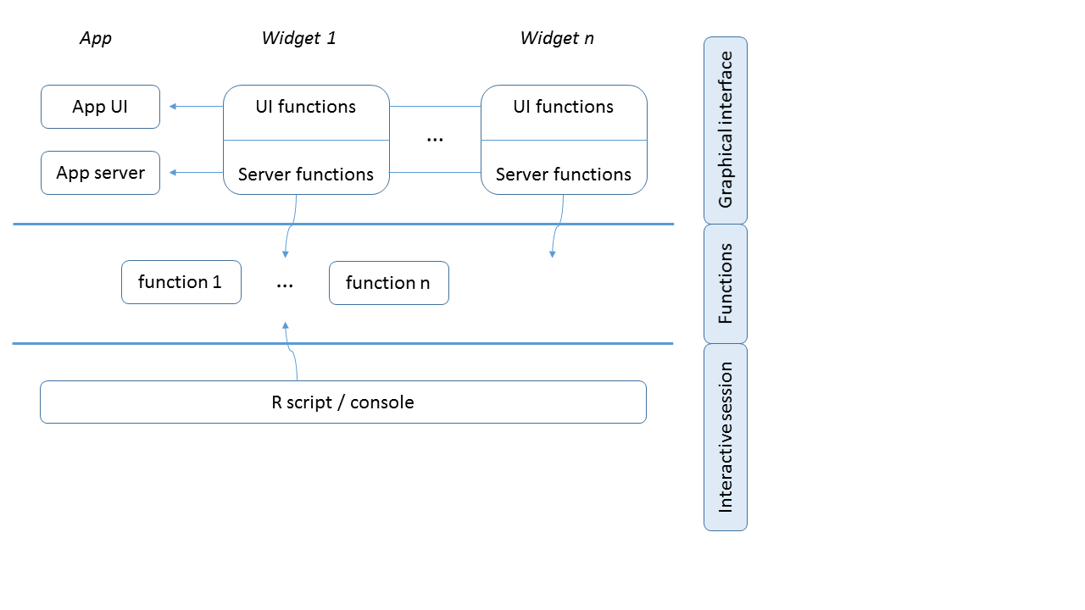
Package structure
The interface is build using ui/server scripts as done in other shiny apps
Due to the size of the dashboard, widget modules were created that are used by ui/server
More generic functions are available that are used by the interface as well as interactive usage

Slide 20
Differences between Interactive Session and Interface
Functionality available in both
View overview of available models
View hierarchical overview
Run models externally
Create parameter table
Create GOF plots
Create fit plots
Functionality only available in interface
Export overview
Adapt model meta data
Edit, duplicate, create model
Show progress of model runs
Combine analysis results in report
Run user created R template script
Functionality only available in interface can be done in many cases indirectly in an interactive session as well
It is more user-friendly/quicker to perform certain tasks using the interface
It is easy to switch between interface and interactive session

Slide 21
Workflow – via nlmixr
A model can be directly run in nlmixr:
Define model using the unified user interface.
Import, create and/or adapt the required data.
Use the nlmixr function to run the model.
run1 <- function() {
ini({
tka <- .5
tcl <- -3.2
tv <- -1
eta.ka ~ 1
eta.cl ~ 2
eta.v ~ 1
add.err <- 0.1
})
model({
ka <- exp(tka + eta.ka)
cl <- exp(tcl + eta.cl)
v <- exp(tv + eta.v)
linCmt() ~ add(add.err)
})
}
dat <- read.csv("data/data.csv")
fit <- nlmixr(run1, dat, est="saem")

Slide 22
Workflow – model diagnostics
print(fit)
plot(fit)
xpdb <- xpose_data_nlmixr(fit)
dv_vs_idv(xpdb)
ipred_vs_idv(xpdb)
pred_vs_idv(xpdb)
dv_preds_vs_idv(xpdb)
dv_vs_pred(xpdb)
dv_vs_ipred(xpdb)
res_vs_idv(xpdb, res = 'CWRES')
res_vs_pred(xpdb, res = 'CWRES')
High level results can be printed in console and default plots can be created using nlmixr.
More elaborate plots can be generated using the xpose.nlmixr package
Most important function is xpose_data_nlmixr which transforms the nlmixr output to xpose format
Subsequently almost all xpose functions can be used to create results for nlmixr output
Only a few functions are displayed, for more examples see:
https://uupharmacometrics.github.io/xpose/index.html

Slide 23
Workflow – via shinyMixR command line
# show first part of model
cat(readLines("models/run1.r")[1:7],sep="\n")
run1 <- function() {
data = "theo_sd"
desc = "base model"
ref = ""
imp = 1
est = "nlme"
control<-list()
ini({
tka <- .5
tcl <- -3.2 ...
# command line
run_nmx("run1")
res <- readRDS("shinyMixR/run1.res.rds")
gof_plot(fit)
fit_plot(res,type="user")
# interface
run_shinymixr()
The model is defined in a separate file (run1.r) and includes metadata used by the package
A model is submitted by default in a separate R session.
Plot functions are available to create xpose.nlmixr or ggplot2 type plots
The interface can be started using a single function

